Slide 1
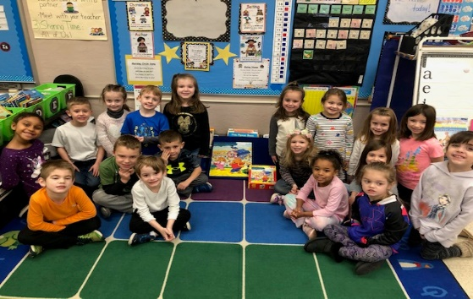
KINDERGARTEN UPDATE February 3rd
Hello Families! Since returning from the holiday break, our class has made leaps and bounds in the areas of mathematics and language arts. The students have completed the addition unit in mathematics, and are moving into subtraction. This week’s homework packet includes addition flashcards that your child must practice once a day in order to master fluency (able to provide the answer within a few seconds). In the area of writing, the students have been writing 3-page narrative stories about their own experiences (e.g. vacations, celebrations, holidays, etc.). We are practicing sentence formation, and adding detail to our stories (e.g. who, what, when, and where). Our reading is really coming along, and I highly encourage you to read with your child every night. This is a perfect opportunity for your child to choose books of interest at their level to read with you, and for you to model reading a book fluently to them. Ask them about how they partner read at school, and have them teach you how to do it! We have completed learning all 52 letters in the alphabet (lower and uppercase), and we continue to practice their sounds and formation. Please use the letter formation guidelines that were previously provided; please notify me if you don’t have them (they should be kept in your child’s folder). We are building 3-letter CVC words (e.g. cat, fog, hut, sit, leg), and part of their homework will concentrate on this skill. During the month of January, we learned about appreciating differences in one another, having patience, and being accepting of others. We learned about Dr. Martin Luther King Jr. and his legacy, fairness, and treating everyone with respect. Looking ahead to the month of February, we will focus on friendship and empathy. A class list for Valentines was sent home last week, and we will be having a card exchange on Friday, February 14th. The most exciting news from our classroom this month is welcoming back Mrs. Donaghy on Friday, February 7th!
This Month:
MATH
Subtracting up to 10; differentiating between + and -
LANGUAGE ARTS
Reader’s Workshop: Bigger Books, Bigger Muscles
 Writer’s Workshop: How-To Books
☺ Phonics: Word Families
SOCIAL STUDIES & Science
Character Education focus: Friendship
Community Helpers
 Winter / Animal Habitats
Reminders: Please refer to the Class Calendar for important dates/events: Valentines for Veterans: Wed. 2/5 3:15 Pizza Lunch: 2/7 Sandyston-Walpack Shout Outs (form found in weekly school newsletter) SWPTO Family Bingo Night: Fri. 2/7 6:30 Family Math Night: Wed. 2/12 Valentine’s Day: Fri. 2/14 (card exchange) Yearbook orders due 2/14 School Closed – 2/17 for President’s Day Pep Rally – Fri. 2/28

